Slide 1
Intro tutorial
R course 2023-2024
Notes:
Due to the chages this year we have 2 tutorials between the first and second class.

Slide 2





The R team
Moodle link: MOODLE
Notes:
Lecturers
Schragi Schwartz: schwartz@weizmann.ac.il
Yaron Antebi: yaron.antebi@weizmann.ac.il
Teaching assistants:
Rotem Tal: rotem.tal@weizmann.ac.il Einav Somech: einav.somech@weizmann.ac.il
Edo Kiper: edo.kiper@weizmann.ac.il
Moodle link:
Feinberg graduate school: Log in to the site (weizmann.ac.il)

Slide 3
The goal
The toolkit
R programming language.
- First part.
Extract meaningful insights from our data.
- We’ll see a fun example after the break.
Notes:
Learning R should go hand in hand with learning how to do analysis. Learning R out of any context can be tedious. Learning how to analyze data using R is fun.

Slide 4
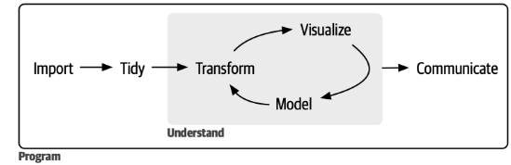
The circle of [data science] life
The tools:
[Basic] Statistical Knowledge.
Understand the data.
Within R programming:
Data Wrangling: The ability to clean, preprocess, and transform raw data into a usable format. Simple example – transform distance and time to speed. Purely technical.
Exploratory data analysis (more in the next slide).
Data Visualization: Create clear and effective visualizations helps in communicating findings.
R Programming language
Notes:
Statistics: We can do a lot with R with basic statistic intuition. On the other hand – with R and statistics the sky is the limit.
We will see a short example of EDA

Slide 5
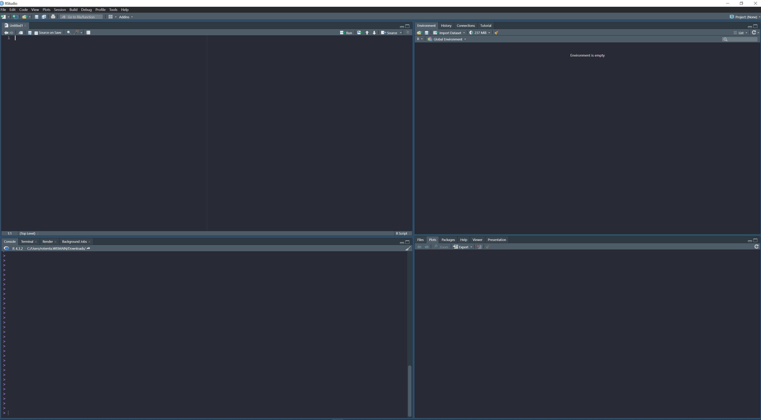
The Rstudio interface
Script
Here is the code that is already working and you wish to keep. Every line of code you run here will be sent to the console.
You can (and will) have multiple script windows.
If you view a table it will appear here. You can pop-out this window to view it in full screen.
Environment
Here you can see all your objects (data) and functions.
History
Previously run code.
Plots
Your amazing plots will appear here.
Files
File explorer (like in the OS).
Help
“?function()” to get the function's description.
Console
Where the code actually run. You usually write code directly to the console when you want to first test it or when you just want to run it only once for any reason.
Notes:
Unlike in word/powerpoint – we barely need to use a top bar. We do everything with code.

Slide 6
We use functions to manipulate our data
The R environment
Functions
Custom
Base R
Packages
Objects (data)
Vector
Numeric / Integer
Character
Logical
Factor
Table
Data Frame
Matrix
list
Notes:
This is

Slide 7
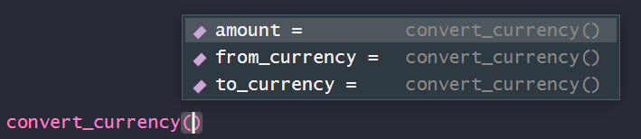
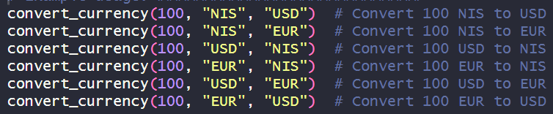
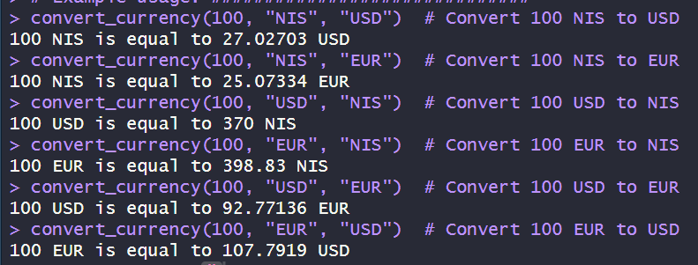
The basic structure of an R function
Function_name(input, Arg1, Arg2, …)
Example – A function to convert NIS, USD and EUR:
The arguments allow me to select which currencies I wish to convert.
You can give R the arguments simply by order. You can but don’t need to specify:
Notes:
The arguments modify the output.
Functions can have any number of inputs / arguments) but only one output.
You can give R the argumens by order. You can but don’t need to specify:
You can see the body of the function by running the function name without the parenthesis (except for primitive functions e.g. “max”)
You can get the function description by running “?function”

Slide 8
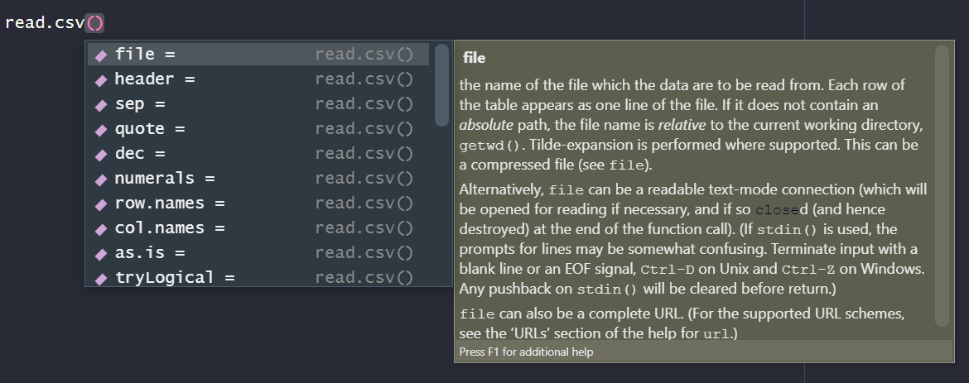
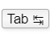
Tip: Click the Tab button when the cursor is within the function. It will show all the function’s arguments

Slide 9
Assigning new objects
Old_object
Output <- function(Input, Arg1, Arg2, …)
New_object
Notes:
A note regarding running functions in the script VS console:
If I run the function without assigning it to an object, the output will be printed in the console but it won't be saved.
The general idea is that in many cases I will first run it without assignment, and only after I’m pleased with the result than I’ll assign it to an object.
If I’m confident with the expected output I can assign straight away.
Assigning new objects from the console is possible, but not recommended because it will lead to a non-reproducible workflow.
Not all functions in R generate assignable output. For example the “view()” function.

Slide 10

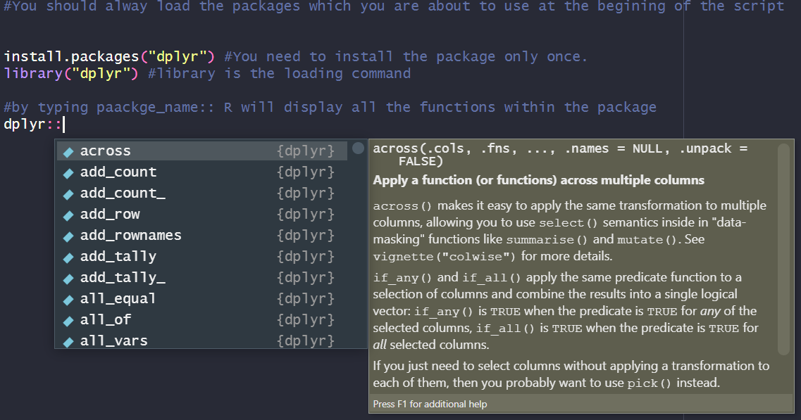
Where does R Functions come from?
Base R: ~4000 functions (practically you only need a fraction of it).
CRAN: ~22k packages with ~dozens of functions in each.
Additional depositories.
Notes:
You can write your own functions. Its very simple, we’ll see how later in the course.
Packages from the CRAN depository can be easily installed using the install.packages() command.
The idea is that for everything you would like to achieve – there is already a package ready for you. This is one of the reasons why R is such an awesome and powerful tool.
CRAN:
The Comprehensive R Archive Network (r-project.org)

Slide 11

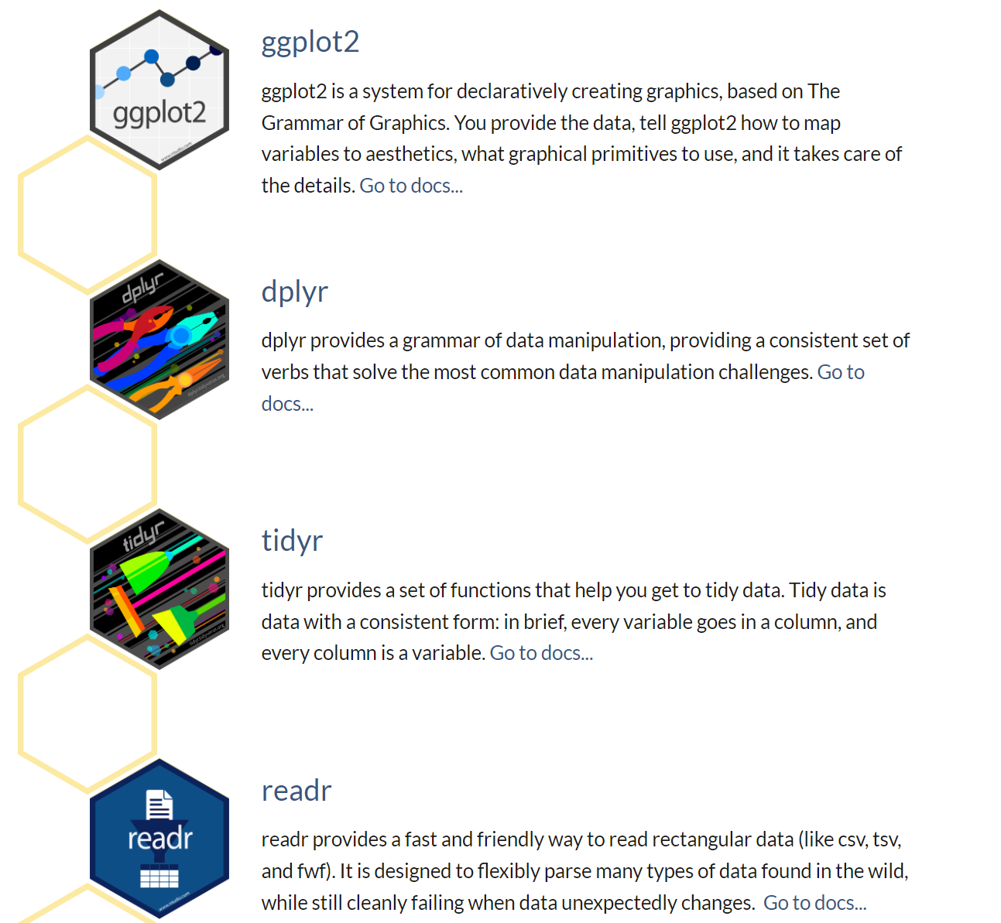
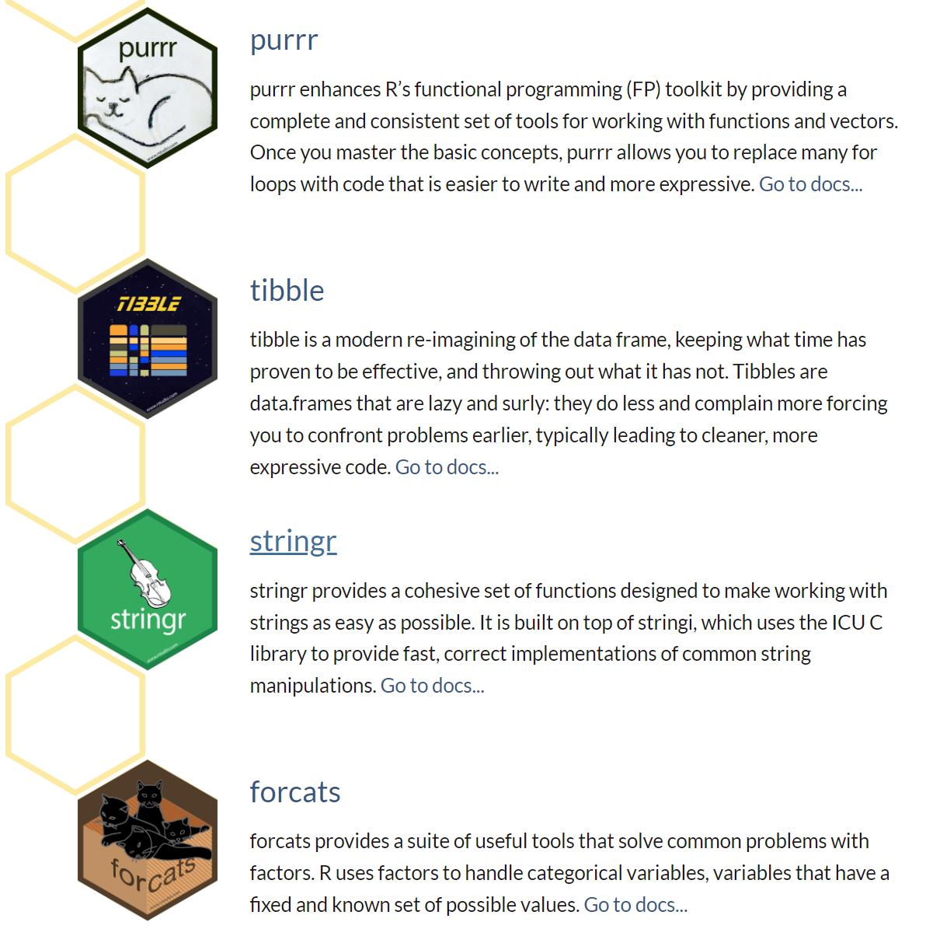
The tidyverse packages
Hadley Wickham
Notes:
Tidyverse VS Base R:
Base R: Traditional, comes with the R installation, uses base data structures, and has a wide variety of functions for different tasks.
Tidyverse: Modern, emphasizes tidy data principles, uses consistent syntax across packages (dplyr, ggplot2, tidyr, etc.), and encourages a more unified approach to data analysis.
Many R users find the tidyverse approach to be more intuitive and user-friendly, especially for data wrangling and visualization tasks. However, both base R and tidyverse have their strengths, and the choice often depends on personal preference and the specific requirements of the analysis.
Ggplot2:
Even in you prefer base R, ggplot2 is still the strongest tool to produce plots.

Slide 12
Data structures in R
The R environment
Functions
Custom
Base R
Packages
Objects (data)
Vector
Numeric / Integer
Character
Logical
Factor
Table
Data Frame
Matrix
list
Notes:
Vectors hold once dimensional data.

Slide 13
Vectors
Vectors are one dimensional data.
Element = 5.
Vector = c(1,2,5,7).
c for concatenate (it’s a function!).
The function length(vector) will return the number of elements.
Subsetting vectors:
The term index refers to the position of elements. We can subset specific elements from a vector by their index using the “subset square brackets:
vector[1:2] - Take the first two elements
vector[-3] - Take all but the third element.

Slide 14
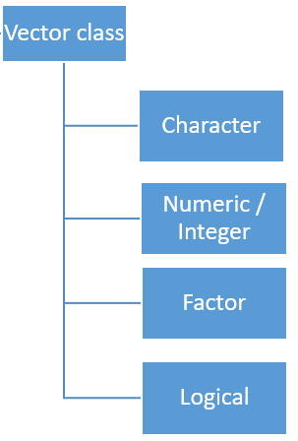
Class
In R, the term "class" refers to the data type or category of an object. The class of an object defines how R treats and handles that object, including what operations can be performed on it and how it behaves in certain contexts.
class(vector) – output which class is the vector.
Notes:
class(vector) what type of data the vector contains.
The concept of class is very technical but important to understand.

Slide 15
Vector class: Character
A character is a sequence of one or more characters, where a character can be a letter, number, punctuation mark, or other symbol. Character vectors are commonly used to store and manipulate textual data in R.
# Creating a character vector
my_characters <- c("apple", "banana", "orange", "grape")
Note that every element in the character vector is inside quotations marks and the elements are separated with commas.
Subset:
my_characters[3]
“orange”

Slide 16
Vector class: factor.
A "factor" is a data type used to represent categorical variables with a fixed and limited set of categories (gender, educational levels etc).
Levels:
The unique values in a factor are referred to as "levels”.
You can access and modify the levels using the levels() function.
The order of the elements in the factor vector is determent by the order of it’s levels.
Factors are useful when we want to determine the order / hierarchy. Or, when we need to group our data.
Elements in factors are also separated by quotations marks.
Notes:
Run:
# Create a character vector for education levels
education_char <- c("High School", "Bachelor's Degree", "Some College", "Master's Degree", "Doctorate")
# Create a factor vector for education levels with a specified order
education_factor <- factor(education_char, levels = c("High School", "Some College", "Bachelor's Degree", "Master's Degree", "Doctorate"))
# Display the character vectorcat("Character Vector:\n")
print(education_char)
# Display the factor vectorcat("\nFactor Vector:\n")
print(education_factor)
You can see the factor is printed with its levels
Dont worry about the last two points. It will become clear later.

Slide 17
Factor are prone to cause problems
In many cases, the default for R is to treat data as factors. Sometimes even for numeric values.
Manipulating factors is limited to the levels: you cannot add a value that is not included as a level. If you remove a value from a factor, the levels stay the same.
Notes:
Many times when I get an error it is solved when I change a factor to a different class.

Slide 18
Vector class: Logical
Vectors containing either TRUE and FALSE values.
Bool = c( TRUE, TRUE, FALSE )
also:
Bool = c( T, T, F )
Notice that you don’t need to use quotation marks.
but not:
Bool = c( True, True, False ).
Logical vectors can also be used for subsetting :
my_characters[F, F, T, F]
“orange”

Slide 19
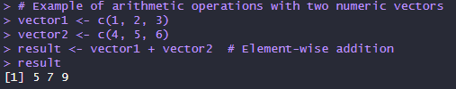
Vector class: Numeric
Numeric vectors are used to represent numerical values. Commonly used in mathematical and statistical operations.
# Correct way to create a numeric vector
numbers <- c(1, 2, 3, 4, 5)
Notice that you don’t need to use quotation marks.
# Incorrect: Mixing numeric and character elements
invalid_numbers <- c(1, 2, "three", 4, 5) # Results in coercion to character.
Arithmetic operation on numeric vectors are performed element-wise:
Notes:
education_factor[2:5]
The high school level didn’t go anywere

Slide 20
Numeric VS integer
In summary, while both numeric and integer vectors can store numerical values, a numeric vector can represent both integers and decimals, whereas an integer vector specifically stores whole numbers.
Notes:
Practically: I always use numeric.

Slide 21
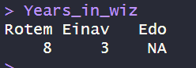
Naming vectors
Names can be assigned to individual elements within a vector using the names() function.
Naming vectors is particularly useful when you want to provide meaningful labels for the elements of a vector, making it easier to access and manipulate specific elements.
Example:
# crate a vector
Years_in_wiz <- c(8, 3, NA)
# NA is evaluated by R as missing data
#Assign names
names(Years_in_wiz) <- c(“Rotem”, “Einav”, “Edo”)

Slide 22
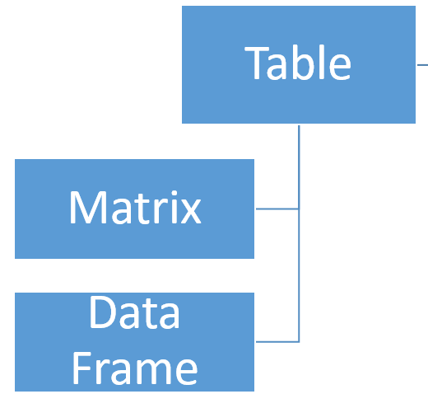
Matrix and data frame – for multidimensional data
Data Type Consistency:
Matrix: All elements in a matrix must be of the same data type. If you attempt to combine different data types in a matrix, R will coerce them to a common type.
Data Frame: A data frame can have columns with different data types.
Functionality:
Matrix: The advantage of a matrix is that you can perform row-wise (e.g. rowSums() ) or matrix by matrix (e.g. matrix multiplication ) operations.
Data Frame: useful when dealing with datasets where different columns may represent different types of information.
Subset:
When subsetting df/matrix: df[row_index, column_index].
Notes:
For example in rnaseq analysis the expression matrix will be a matrix and the metadata will be sored in a data frame

Slide 23


List and last – The list
Lists in R are versatile data structures that can hold elements of different types, including vectors, matrices, data frames, and even other lists. In other words, lists are kind of a “kitbag” that you can use to store multiple objects of any type in one place. Provides versatility.
Elements in a lists can also be named using the names() command.
For example: If you want a function to iterate over several objects, you can put them in a list (will be elaborated later in the course).
Notes:
At this point I just want you to remember that list = kitbag
# Create a list with various data classes
my_list <- list(
integer_vector = c(1L, 2L, 3L),
numeric_vector = c(1.5, 2.8, 3.1),
character_vector = c("apple", "banana", "orange"),
logical_vector = c(TRUE, FALSE, TRUE),
data_frame = data.frame(ID = c(1, 2, 3), Name = c("Alice", "Bob", "Charlie")),
factor_vector = factor(c("low", "medium", "high"), ordered = TRUE, levels = c("low", "medium", "high"))
)
# Display the list
print(my_list)

Slide 24
The $ operator
The $ operator is used to extract elements from a list or data frame. It allows you to access a specific named element or column within a list or data frame directly.
# Create a list
my_list <- list(name = "John", age = 25, city = "New York")
# Accessing elements using the $ operator
name_from_list <- my_list$name
age_from_list <- my_list$age

Slide 25
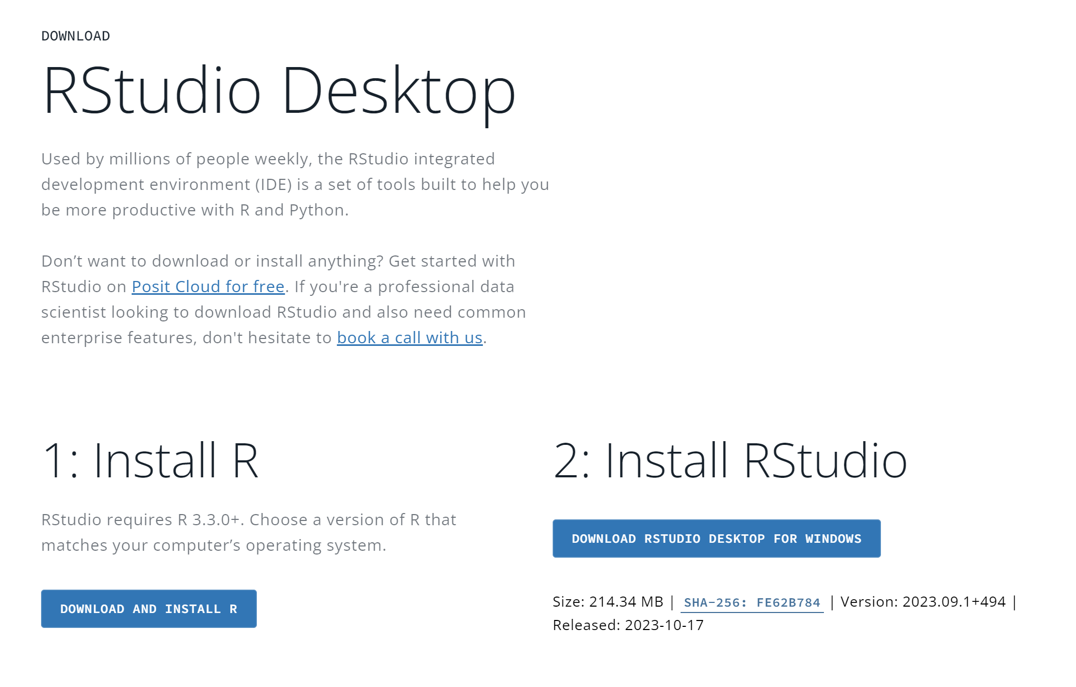
BREAK – Make sure you have Rstudio working
Recommended: Tools > global options > appearance > select a theme.
Notes:
R
Windows: https://cran.rstudio.com/bin/windows/base/R-4.3.2-win.exe
Mac M1/M2: https://cran.rstudio.com/bin/macosx/big-sur-arm64/base/R-4.3.2-arm64.pkg
Mac (Intel): https://cran.rstudio.com/bin/macosx/big-sur-x86_64/base/R-4.3.2-x86_64.pkg
Rstudio
Windows: https://download1.rstudio.org/electron/windows/RStudio-2023.09.1-494.exe
Mac OS 12+: https://download1.rstudio.org/electron/macos/RStudio-2023.09.1-494.dmg

Slide 26
The circle of [data science] life
The tools:
[Basic] Statistical Knowledge.
Understand the data.
Within R programming:
Data Wrangling: The ability to clean, preprocess, and transform raw data into a usable format. Simple example – transform distance and time to speed. Purely technical.
Exploratory data analysis (more in the next slide).
Data Visualization: Create clear and effective visualizations helps in communicating findings.
R Programming language
Notes:
Statistics: We can do a lot with R with basic statistic intuition. On the other hand – with R and statistics the sky is the limit.
We will see a short example of EDA

Slide 27
Exploratory data analysis (EDA) Best practice
There is no “one-fits-all” pipeline for EDA.
When we fist upload a new dataset, we usually first need to make sure it’s tidy, than we start to explore it (eg. find the sources of variability = what's interesting).
Only after initial exploration we can start the creative process and think what questions we want to ask and plan how we to model and visualize the data to find answers.
EDA philosophy
“There are no routine statistical questions, only questionable statistical routines.” — Sir David Cox.
“Far better an approximate answer to the right question, which is often vague, than an exact answer to the wrong question, which can always be made precise.” — John Tukey.
“Sometimes science is more art than science Morty.” – Rick sanchez. #ggplot2

Slide 28
Lets do some EDA on the Netflix dataset!

Slide 29
1. Load the csv file into our environment
#option A define path as an object
path <- "path/to/file"read.csv(file = path, header = FALSE)
#option B insert path directly
NETFLIX_DATA <- read.csv(file = "path/to/file", header = FALSE)
Notes about the path argument
Text should be within parenthesis.
Dash lines for paths should be within quotation marks.
Slashes in R need to be to the right (opposite from windows).
Notes:
You can write whatever you want after the #
In a new line – only valid functions.
Copy to R and try:
#option A define path as an object
path <- "path/to/file"read.csv(file = path, header = FALSE)
#option B insert path directly
NETFLIX_DATA <- read.csv(file = "path/to/file", header = FALSE)
# If you run an object name, the object will be printed in the console.
path

Slide 30
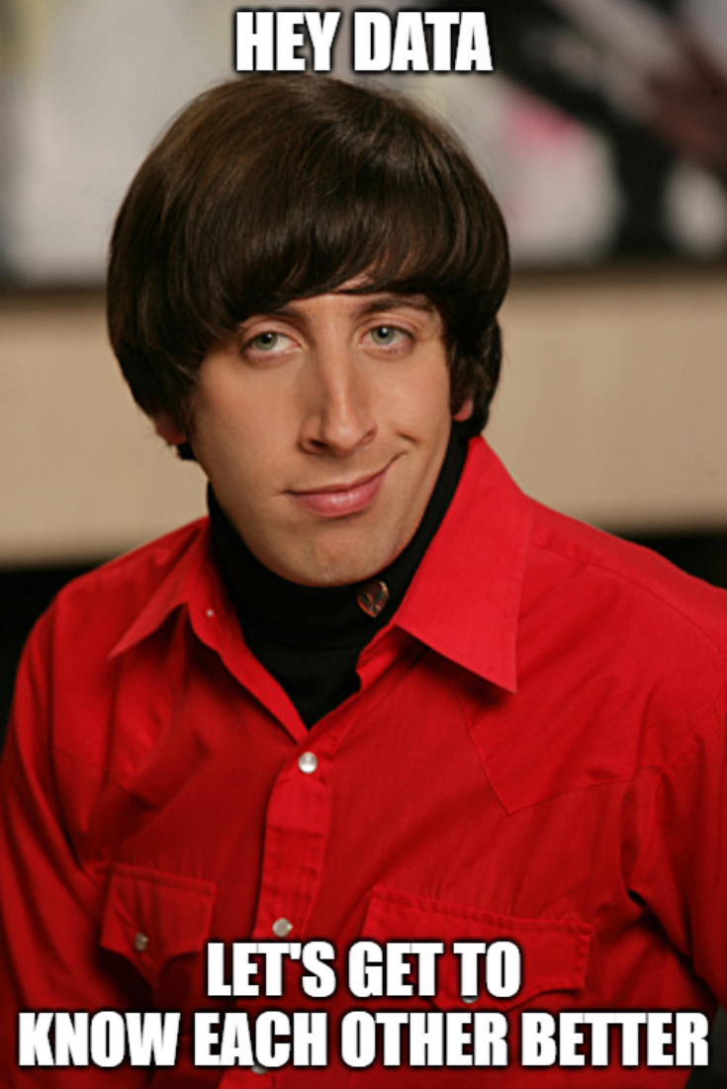
2. Get some feeling for the data – try yourself!
These are functions that takes a data frame as input:
View()
dim()
colnames()
rownames()
Notes:
Every time we encounter a new data set we need to run some code just to “get a feeling” for it (e.g. distributions, parameters, is it tidy?).

Slide 31
2.1 Bonus if you have time
These are functions that takes a vector as input:
Try to use the $ operator to select specific columns from the data frame and use it as input.
length(netflix_data$column)
class(netflix_data$column)
Try to find a numeric column and explore it’s distribution with:
hist(netflix_data$numeric_column)
plot(netflix_data$numeric_column1, netflix_data$numeric_column2)
summary(netflix_data$numeric_column)
Notes:
Every time we encounter a new data set we need to run some code just to “get a feeling” for it (e.g. distributions, parameters, is it tidy?).

Slide 32
Until the end of the class
You don't need to fully understand or memorize the next slides. This is just a demonstration for you to see the bigger picture of how simple EDA is done with R ☺. You will have the entire course to learn how its done.

Slide 33
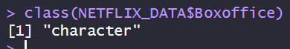
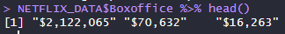
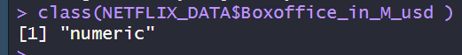
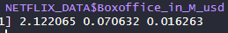
3. Tidy up: Fix the box office column
Original column
My “Tidy” version
This is an example for why vector type matter. “$70,632” is evaluated by R as a character because of the “$”.
I removed the “$” and divide by 1M –to create a new tidy column: Boxoffice_in_M_usd
Notes:
This data set is very messy. This is just one example that I choose because its needed for my downstream analysis.

Slide 34
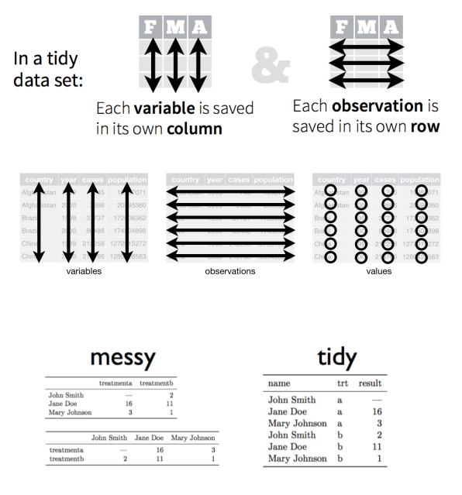
What is - Tidy data?
Notes:
First thing we do after we load new data into R it to make sure its tidy. If not – make it tidy before you proceed.

Slide 35
4. Define questions and relevant parameters
I want to use the data to know: Who are the most successful directors on Netflix?
Define the relevant parameters:
Sales (box office) – total / avg per movie?
Rating: IMDB / metacritic/ rotten tomatoes / Netflix view rating?
Total number of titles?
How many awards received?

Slide 36
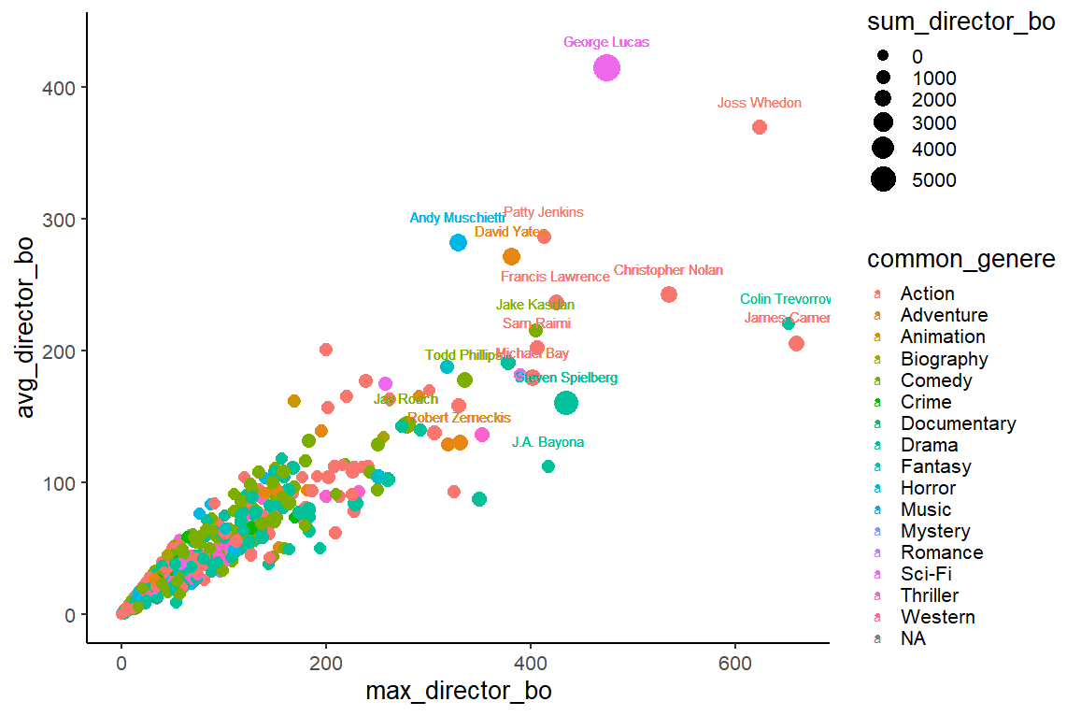
5. Envision your plot

Slide 37
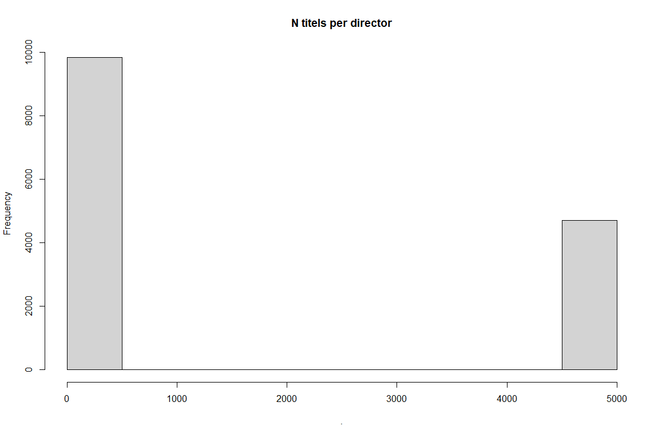
6. Remove “noise” - Should I filter out some directors?
4700 titles with no director name.
Notes:
What can explain this distribution?
Did I do something wrong?

Slide 38
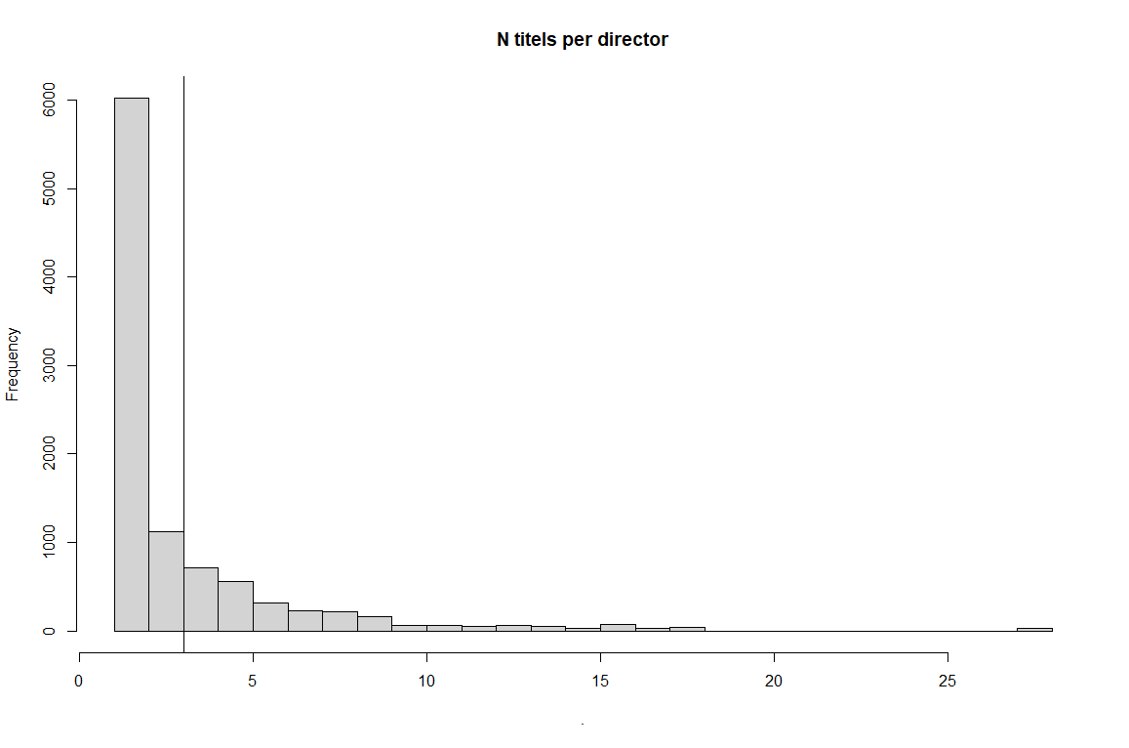
Now after we filtered out titles with missing director
Notes:
I assume that if I want to average the BO and select common genre I should have at least 3 data points. Also, my data intuition tells me that directors with only 1-2 movies are not what I’m looking for. Their BO numbers will be very low and hence they give me more noise than information.

Slide 39
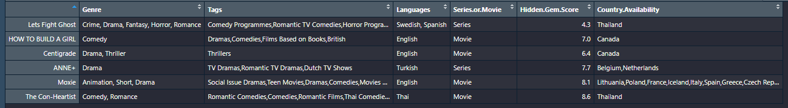
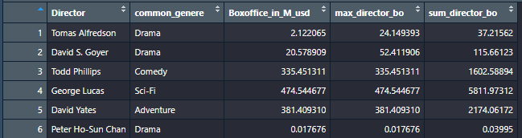
Data manipulation
Rows
=
titles
Rows
=
Directors
Plot
Notes:
Problem: non of the data aesthetics in my plot is found in my data
I need to group the data by director.
Find the common genre, max and avg BO, sum the BO

Slide 40
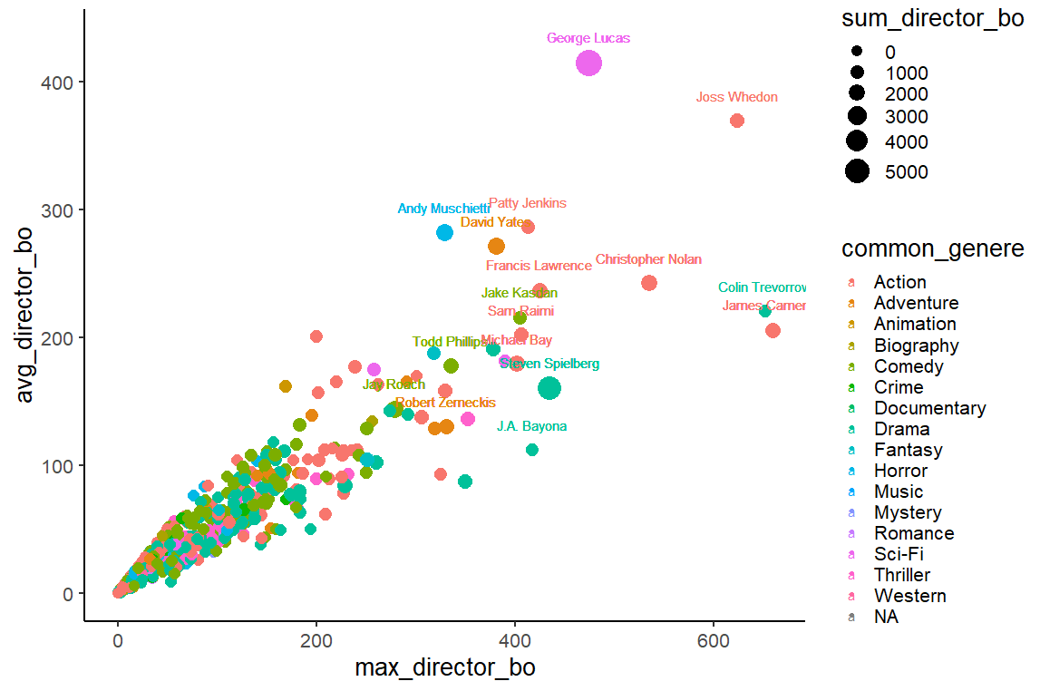
7. Plot.
Look how much can we learn with simple data manipulation and one plot!
Notes:
MAX BO in Netflix: James Cameron the titanic
Who made most money – Gourge lucas.
Andy Muschetti stands out in horror movies

Slide 41
8. Ask what is wrong? Any outliers?
Notes:
How can there be such high correlation between the max_BO and the AVG_BO?

Slide 42
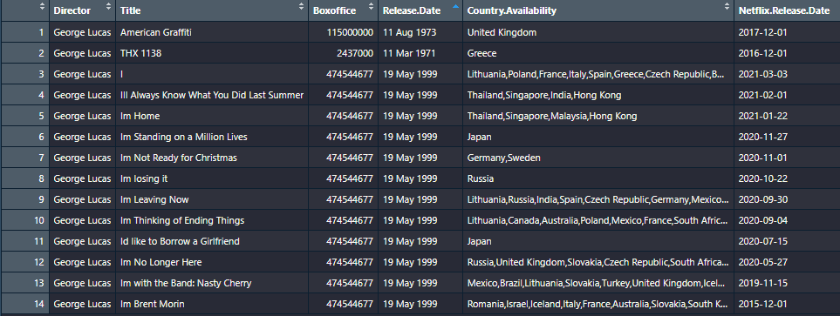
This is what we call duplicates (Star wars episode I)
Notes:
The title names are wrong.

Slide 43
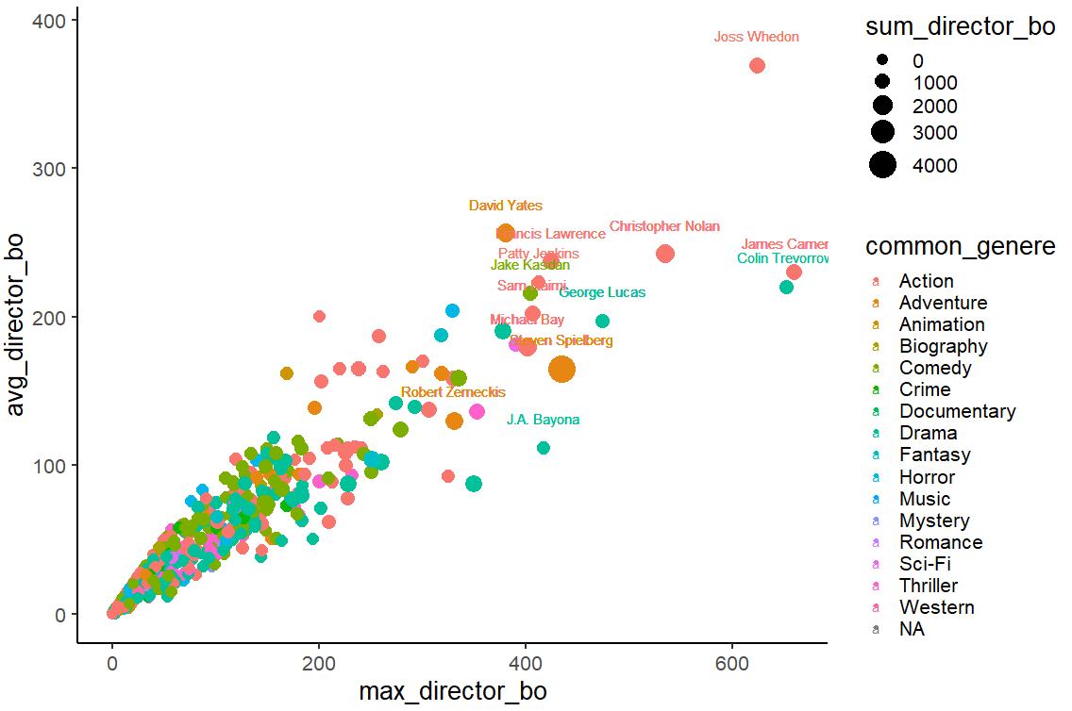
9. Fix and repeat: Removing release.date column duplicates
Notes:
The EDA circle goes round again and again until everything fells right and the final plot is ready.

Slide 44

My first R commands
At The beginning of the script:
install.packages()
library()
load.csv
Create data structures:
c() – for character, numeric and logical vectors.
factor(x, levels = ())
data.frame()
matrix()
Initial data exploration:
View()
names()
length()
dim()
colnames()
rownames()
class()
summary()
Basic plotting:
hist()
plot()
Notes:
You can do so much only with those 18 basic commands. It is recommend that you’ll take some time to memorize it. You can ask R for any function’s description. For example:
?names()

Slide 45

Now you are on your path to become R master!

